Slide 1


Robotic Process Automation
NewsNow: Automated News Retrieval System
Your Register No. 220701255
Name: SEENUVASAN S
Guide Name: Dr. N. Durai Murugan,M.E., Ph.D.,
Designation and Department: Assistant Professor (SG),
Department of Computer Science and Engineering.

Slide 2
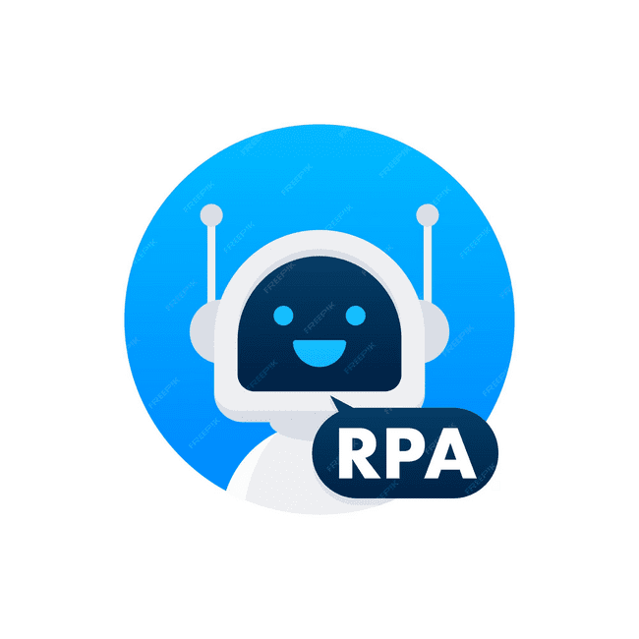
Abstract
The "Smart News Retrieval and Delivery Bot" automates the process of retrieving the latest news and delivering it to users based on their chosen topics. Using Robotic Process Automation (RPA) and UiPath, the system performs a Google search for recent news articles, filters them to include only the most recent ones, and sends the headline and link to the user’s email. This project is designed to save time and effort, ensuring users stay updated on their topics of interest effortlessly.

Slide 3

Need for the Proposed System
In today's fast-paced digital age, manually searching for relevant and recent news can be time-consuming. Traditional methods often fail to ensure timely and personalized updates. This bot solves this problem by automating the entire process, delivering real-time, topic-specific news directly to the user’s inbox.

Slide 4

Advantages of the Proposed System
Fully automated, saving time and effort.
Filters outdated content, ensuring only recent news is retrieved.
Delivers news directly via email, improving accessibility.

Slide 5
Literature Survey
1. "Robotic Process Automation: A Systematic Literature Review"
Source: Springer
Link: https://link.springer.com/article/10.1007/s12525-019-00365-8
Advantage: Automates repetitive, rule-based tasks, reducing human errors.
Disadvantage: Less effective in unstructured environments due to dependence on structured inputs.
2. "Robotic Process Automation: In-Depth Analysis of Advanced Automation Techniques and Technologies"
Source: IEEE Xplore
Link: https://ieeexplore.ieee.org/document/10649336
Advantage: Demonstrates how RPA improves operational efficiency by automating repetitive, rule-based tasks.
Disadvantage: Highlights scalability challenges when implementing RPA in complex systems.

Slide 6

Main Objective
To provide an automated, efficient, and user-friendly system for retrieving and delivering the most recent news on user-specified topics.

Slide 7
Architecture
The system consists of:
Input Module: Accepts the topic and email address from the user.
Search Module: Performs a Google search for the latest news.
Filter Module: Identifies recent articles with the "hours ago" timestamp.
Delivery Module: Sends the headline and link to the user's email.

Slide 8
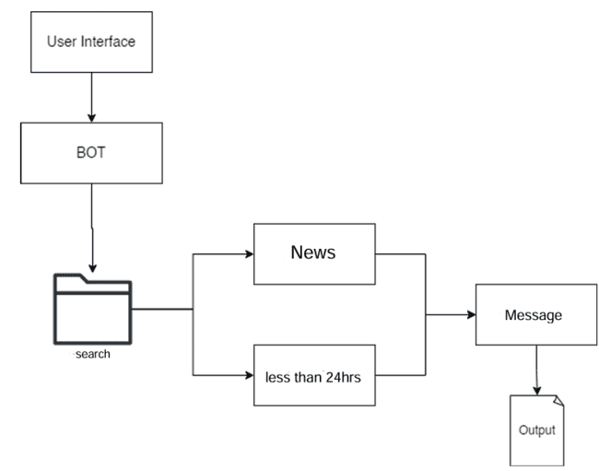
ARCHITECTURE

Slide 9
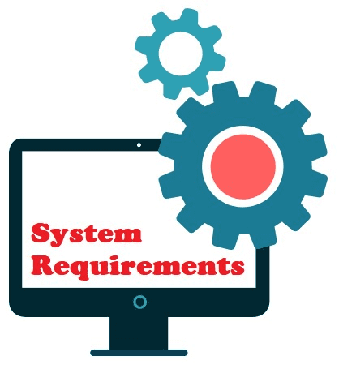
System Requirements
Hardware: PC or Laptop with UiPath Studio installed.
Software: UiPath Studio, Email API/SMTP settings.

Slide 10
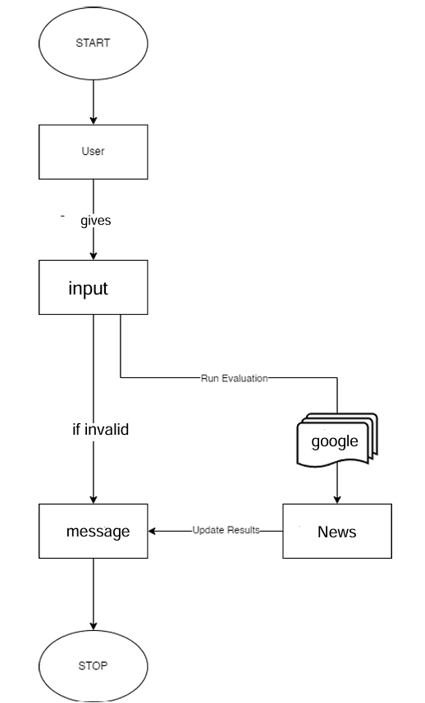

Functional Description
Module 1: Input Handling
Accepts the topic and email via a dialog box.
Module 2: Search and Delivery
Automates Google search, filters results, and sends email.

Slide 11
Process Design
User Input Handling
Collects the topic and email address via a dialog box.
Ensures both fields are filled before proceeding.
News Search
Performs an automated Google search based on the given topic.
Filtering News Articles
Selects only articles with “hours ago” timestamps for recency.
Headline and URL Extraction
Extracts the headline and link of the latest relevant article.
Email Delivery
Sends the headline and article link to the user’s email.
Error Handling
Handles issues like invalid input, no recent news, or connectivity problems.

Slide 12
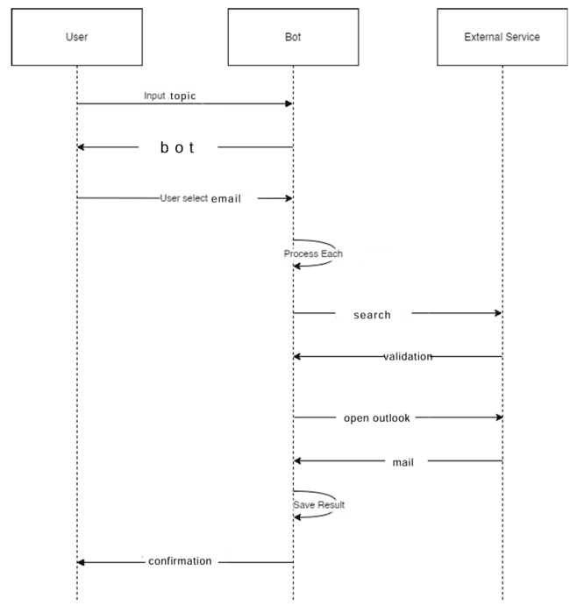
SEQUENCE

Slide 13
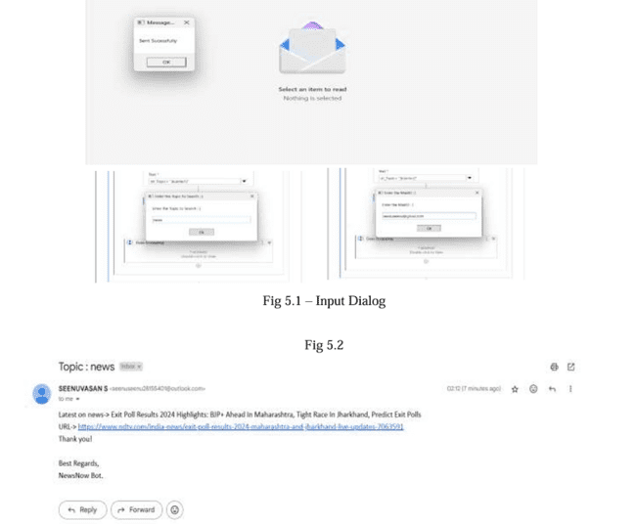
Testing
Test case: Verifying input handling, accurate filtering, and email delivery.
Screenshots:

Slide 14

Conclusions
The project successfully automates news retrieval and delivery, offering a practical solution to save users time and effort while ensuring they stay updated with the latest information.

Slide 15

Future Enhancement
Retrieve multiple headlines at once.
Integrate advanced filtering options like news source preferences.

Slide 16
IEEE Paper
1. "Robotic Process Automation: In-Depth Analysis of Advanced Automation Techniques and Technologies"
Source: IEEE Xplore
Link: https://ieeexplore.ieee.org/document/10649336
Advantage: Demonstrates how RPA improves operational efficiency by automating repetitive, rule-based tasks.
Disadvantage: Highlights scalability challenges when implementing RPA in complex systems.

Slide 17
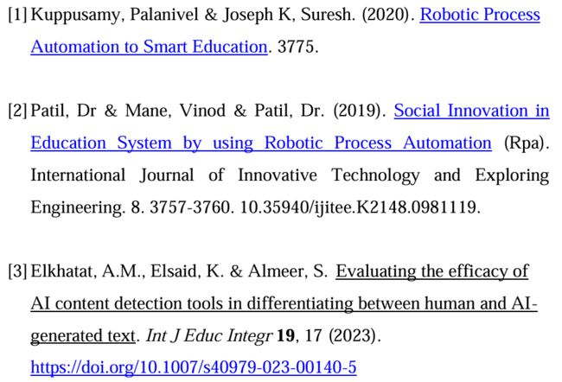
References

Slide 18
Queries

Slide 19
Demonstration

Slide 20
Thank You

